Slide 1
HACKEAM-18 10&11 February 2018, NSIT, New delhi

Slide 2

Team Name: Code warriors
Team Members:
Ashutosh K. Singh
Gautam Rishi
AJAY KUMAR GARG ENGINEERING COLLEGE
Ghaziabad, U.P.

Slide 3
Problem Statement
Our problem Statement is related with the Education and on trek we identified that few children who are willing to study can't make to the school as low background.

Slide 4
Vision
Our teams vision is to create a platform where we can
provide is to help children to get admission in the school.
through this app a mentor will select a student or group and
teach them for a while and if students do well they will be
listed in the app and other users can make the donation to
the well-performing student which we eventually help them
to get admission in the school.

Slide 5
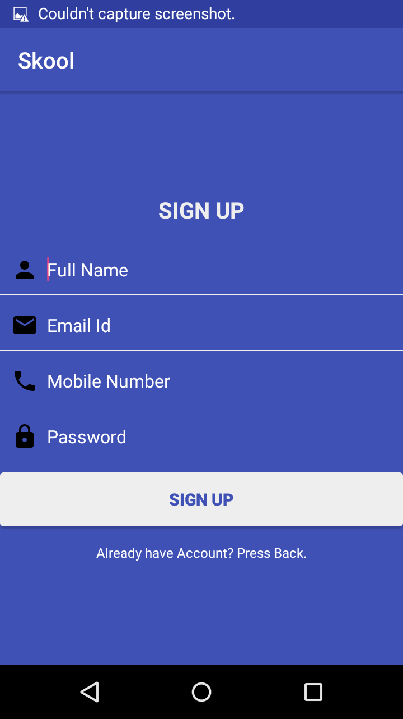
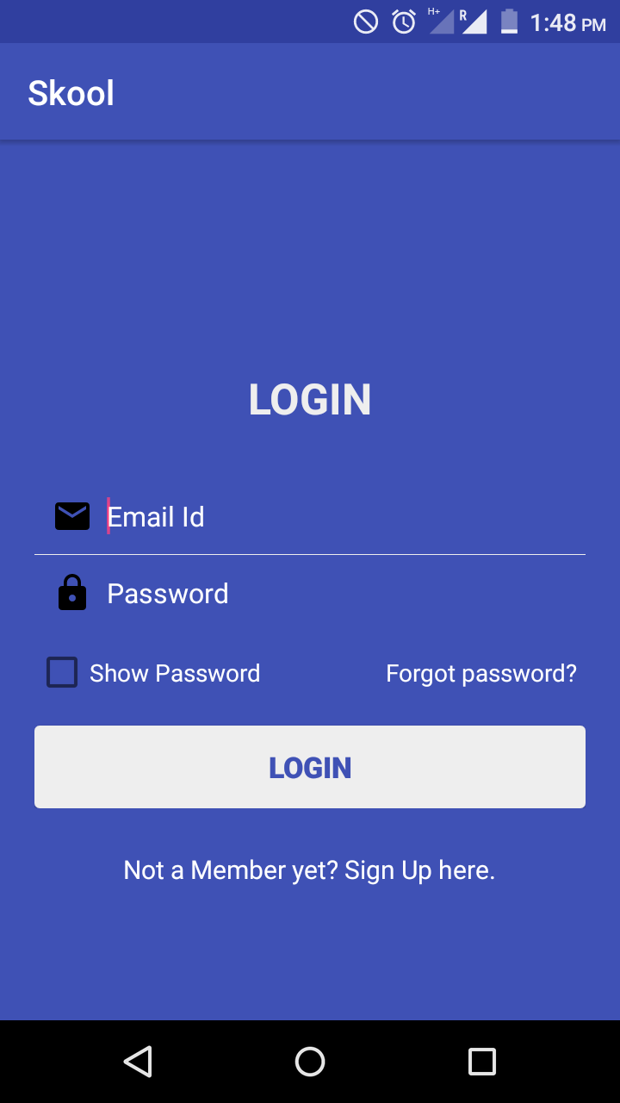

Slide 6
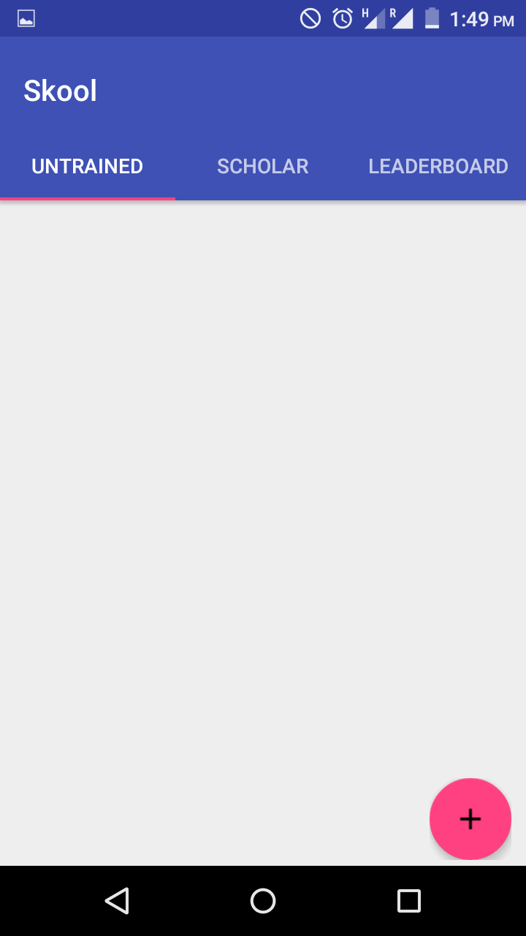
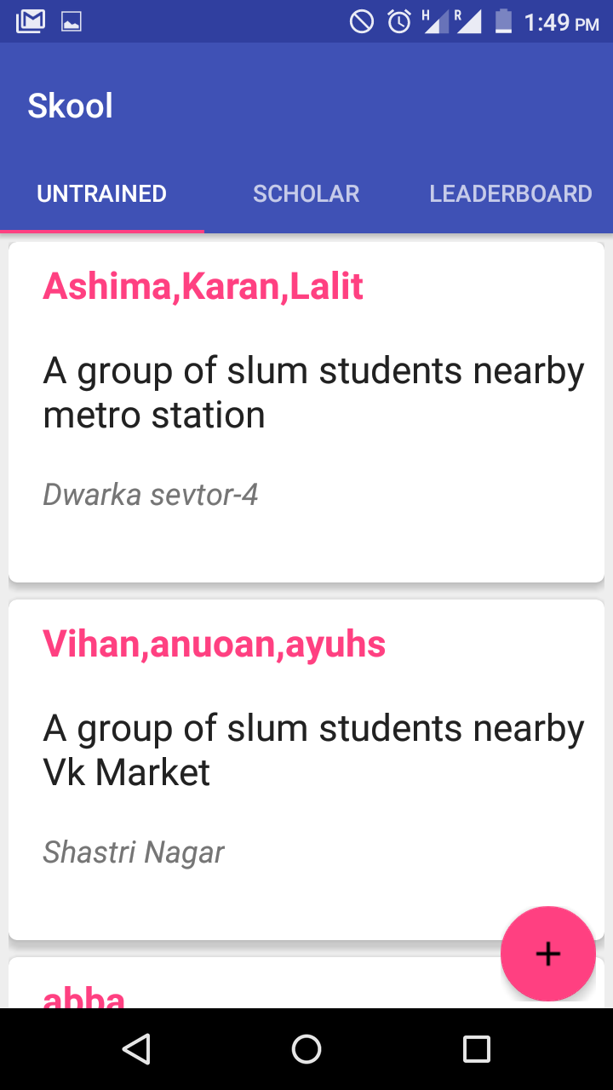

Slide 7
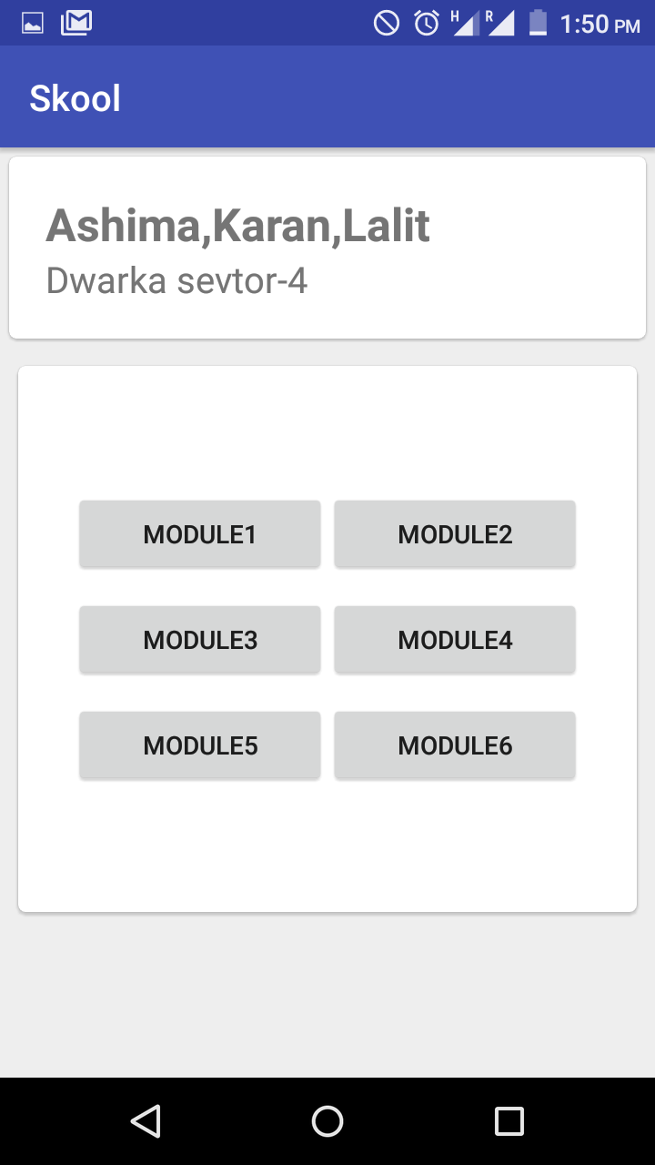
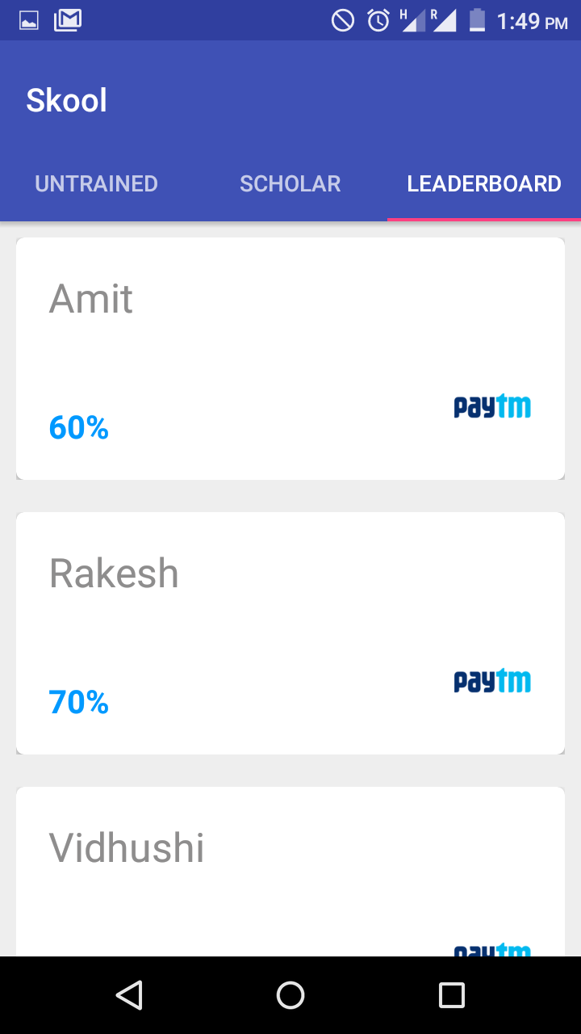

Slide 8
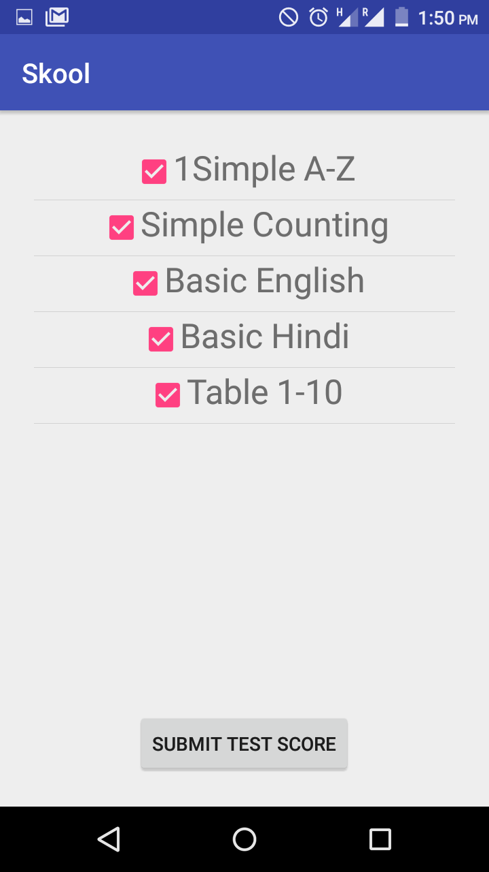
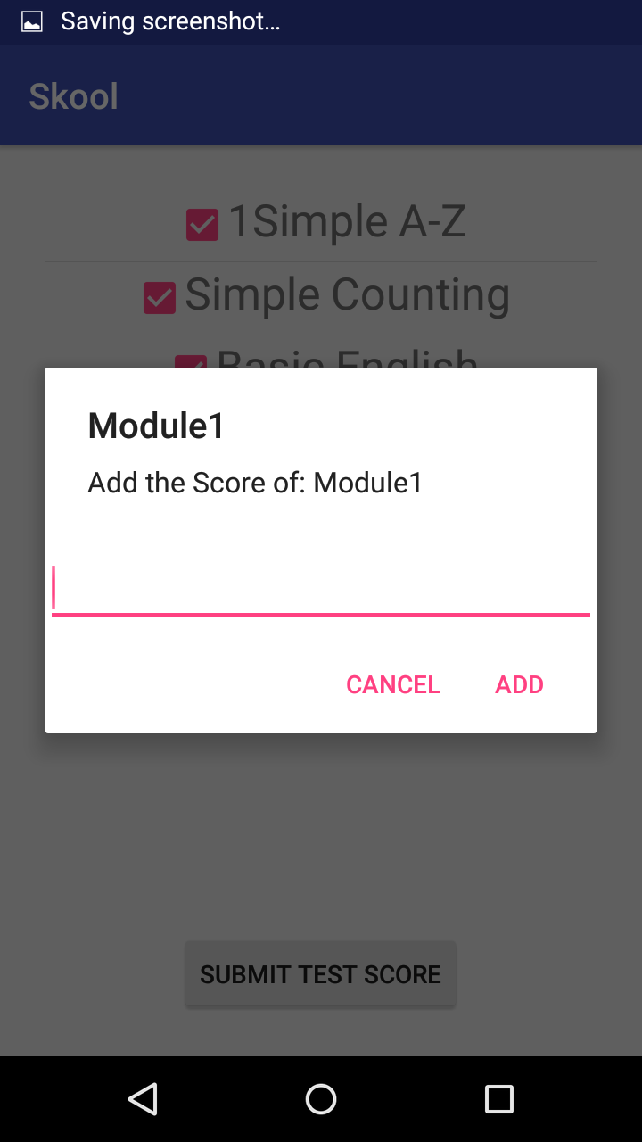

Slide 9
Technology Used
Android
Firebase
Open Source Library

Slide 10
Business Model
Our app works on a very simple business model. It connects tutor to children based on their Geographical area where one is interested in servicing another.
A sum of money from our paid section will be shared between us for each transaction.

Slide 11
Execution Plan
Untrained
DETAILS
Modules
AUTHENTICATION
Modules Detail
Detail activity
Scholar
DETAILS
Modules
Test Score Submitted
Leader Boards

Slide 12
FUTURE PLANS
We have plans to certified this app from NGO’s.
We have plans to get it in business by investment from some of our user.
After every course completion ,Tutor is given ranking according to review by students whom he was teaching.

Slide 13
Thank You
Team CODE WARROIRS

